Slide 1
Seeking consensus for IEC fluoroscopy on colour dose mapping of skin doses
The recently updated IEC 60601-2-43 standard requires, in sub-clause 203.6.4.5, the availability of a radiation dose map.
Consensus was not garnered within the IEC Maintenance Team therefore the current standard does not specify the dose nor colour scales of the map.
Group: Steve Balter, Kevin Wunderle, Donald Miller, Colin Martin, We-Chung Cheng, Andy Rogers

Slide 2
Table on form used to collect dose levels and recommended colour selections
Form was used to seek views of medical physicists from a selection of European countries involved with interventional radiology to determine what considered to be the best options.
The form was completed by groups of medical physicists who had experience in interventional radiology or cardiology to represent collective views from each group.
Colin Martin
Dose level to trigger colour change (Gy)
Suggested colour

Slide 3
Colour schemes proposed for skin dose mapping

Slide 4
Consultation on IEC fluoroscopy colour skin dose mapping
There was a general consensus that high contrast boundaries were required.
The colour scale should be ordered from cool to hot in colour temperature, corresponding to low and high dose respectively.

Slide 5
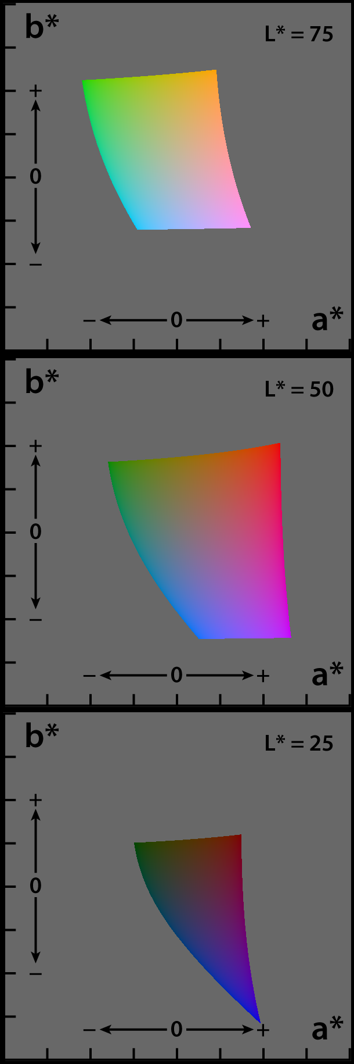
CIELAB colour space
CIE L*a*b* (CIELAB) is a colour space specified by the International Commission on Illumination (French Commission internationale de l'éclairage, hence its CIE initialism).
It describes all colours visible to the human eye in terms of three coordinates, for use as a reference independent of the device.
L*- lightness of the colour (L* = 0 black; L* = 100 diffuse white)
a* - shade between magenta and green (a* -ve green, +ve magenta)
b* - shade between yellow and blue (b*-ve blue, +ve yellow)
It is used in many ISO and IEC standards and so is more suitable than a RGB specification.
The conversion between CIELAB and sRGB is well defined and known to the display vendors.

Slide 6
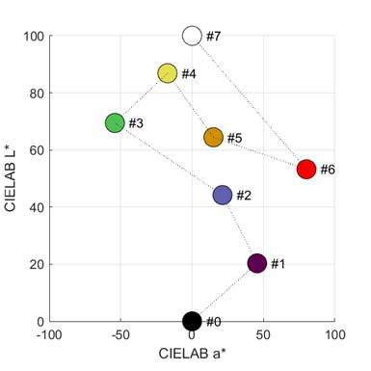
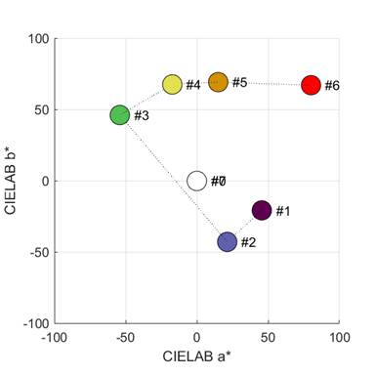
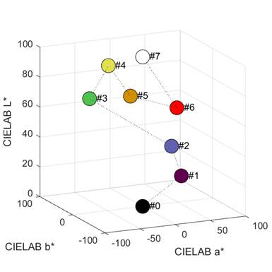
Visualization of 8 colours in CIELAB space
Views from the side
Steps 0, 1, 2, 3, 4, and 7 are in order while Steps 5 and 6 are in reversed order between 2 and 3.
View from the top (chromaticity plane). Steps 0 and 7 are grey shades overlapped on the origin (a*=0 and b*=0). The angle between each colour and the origin is hue.
3D plot in CIELAB space
Steps 1 to 6 for decreasing hue (from cool to hot) should form a circle or a spiral curve in the chromaticity plot.
The hue gap between Steps 2 and 3 is much wider than the others, so another step could be added here, as an alternative.

Slide 7
Colour target values
We want to define the optimal colour target values, based on maximized distances in colour space for greatest differentiability.
We have done this in terms of Red Green Blue (RGB) targets.
These can then be translated into other colour schemes such as CEILAB.
The aim is to replace the current target values with ones that have been maximized for distance in CEILAB space.
The first step from black to something just distinguishable from black, such as dark grey, just gives background to the map and offsets it from black.
These will be used on medical displays in fluoroscopic imaging suites.

Slide 8
Colour schemes proposed for skin dose mapping

Slide 9
Dose levels and colour schemes proposed for skin dose mapping
0.1 Gy
1 Gy
2 Gy
3 Gy
5 Gy
8 Gy
12 Gy

Slide 10
Consultation on IEC fluoroscopy colour skin dose mapping
There was a large variation in the proposed dose scales.
A low dose boundary was favoured in order to provide a reference for the area covered.
European countries favoured boundaries at 1 Gy, 2 Gy, 3 Gy and 5 Gy
The US physicists were not convinced of the need for a 3 Gy boundary, but wanted markers up to high dose levels.
Concern was expressed that the use of green for 2-3 Gy suggested this was a safe level.
Some responders favoured a continuous colour scale

Slide 11
Dose ranges in terms of skin effects
Dose level | 2-3 Gy | 3-5 Gy | 5-8 Gy | 8-12 Gy | > 12 Gy
Possible effects | Tissue reactions unlikely to occur | Transient erythema and epilation. Recovery from hair loss. | Erythema and epilation appear within 2-8 weeks. Erythema may be prolonged. | Transient erythema expected as a prompt effect. Skin desquamation, Prolonged epilation. | Permanent epilation. Dermal atrophy/ induration
Risk | Minor | Low | Moderate | Likely | Expected
If orange were removed, turquoise inserted between blue and green, and colour scheme moved upwards, then the green level would be set at a dose where skin effects might occur.

Slide 12
Dose levels and colour schemes proposed for skin dose mapping
0.1 Gy
1 Gy
2 Gy
3 Gy
5 Gy
8 Gy
12 Gy

Slide 13
Recommendations for IEC fluoroscopy colour skin dose mapping
The dose map displayed to the fluoroscopy operator is intended to be a rough, corner-of-the-eye, indicator of the radiation dose distribution.
Steps with moderate dose increments are most appropriate, with sharp changes in colour to make each step boundary completely obvious.
The dose values were chosen in order to :
provide operators with an early indication of regions of the skin receiving higher doses, so that they can consider the need for optimization.
allow monitoring to continue when the dose has increased to the level where tissue reactions are likely, so that operators can consider further modifications to their technique.
A black and white option will also be available.

Slide 14
Conclusions
There is general consensus that high contrast boundaries are required.
The colour scale should be ordered from cool to hot in colour temperature, corresponding to low and high dose respectively.
The green band should be at a level where skin reactions are unlikely.
Dose levels provide guidance both in the early and later stages of a procedure.
The proposal has been approved by one committee of AAPM, this will have to go through many iterations and approvals from several societies before it can be taken back to the IEC as a potential standard.
Support from IPEM would help towards achieving this goal.

